Slide 2

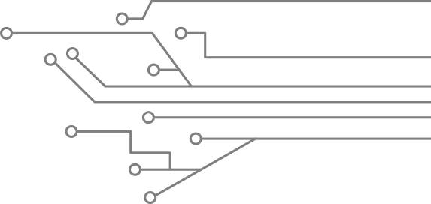


MY SQL
L
BASIC DATABASE CONCEPT
BY THINLEY TOBGAY

Slide 3



Outline
Data, information,
database management
Relational Databases
Database Management System (DBMS)
Entity Relationship Modelling
ER Diagrams
Normalization

Slide 4

Database Management Systems
Data: It is a collection of information.
➔ The facts that can be recorded and which have implicit meaning known as 'data'.
➔ Example:
➔ Customer ----- 1. cname. 2. cno. 3. ccity

Slide 5
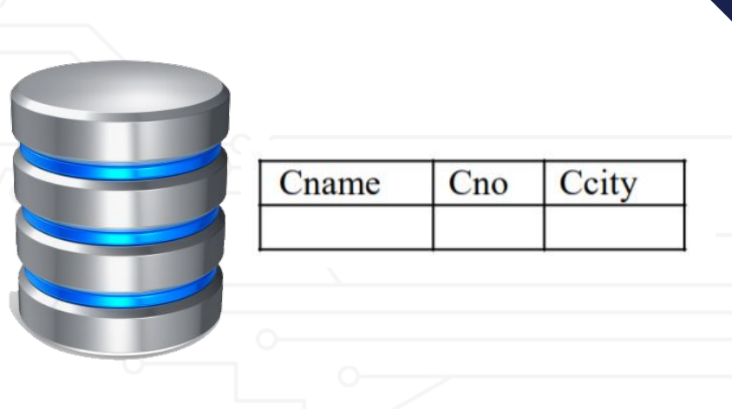
Contid…
Database: It is a collection of interrelated data . These can be stored in the form of tables.
◆ A database can be of any size and varying complexity.
◆ A database may be generated and manipulated manually or it may be computerized.
➔ Example:
➔ Customer database consists
the fields as cname, cno, and ccity

Slide 6

CONTID..
Database System: It is computerized system, whose overall purpose is to maintain the information and to make that the information is available on demand.
Advantages:
1. Redundancy can be reduced.
2. Inconsistency can be avoided.
3. Data can be shared.
4. Standards can be enforced.
5. Security restrictions can be applied.
6. Integrity can be maintained.
7. Data gathering can be possible.
8. Requirements can be balanced.

Slide 7
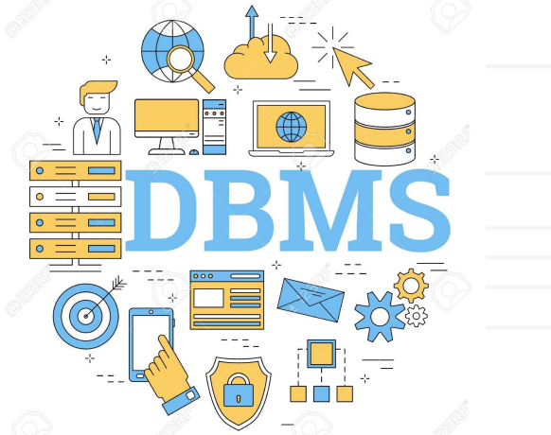
Database Management System (DBMS)
➔ It is a collection of programs that enables user to create and maintain a database. In other words it is general-purpose software that provides the users with the processes of defining, constructing and manipulating the database for various applications.
Disadvantages in File Processing
◆ Data redundancy and inconsistency.
◆ Difficult in accessing data.
◆ Data isolation.
◆ Data integrity.
◆ Concurrent access is not possible.
◆ Security Problems

Slide 8

Advantages of DBMS
1.Data Independence.
2. Efficient Data Access.
3. Data Integrity and security.
4. Data administration.
5. Concurrent access and Crash recovery.
6. Reduced Application Development Time.

Slide 9
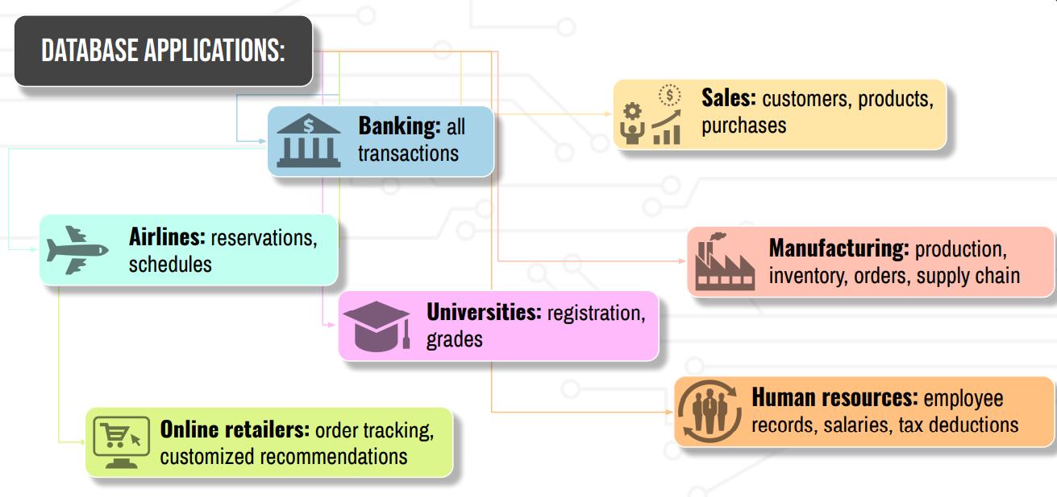
Applications

Slide 10

People who deal with databases
Many persons are involved in the design, use and maintenance of any database. These persons can be classified into 2 types as below.
◆ Actors on the scene
◆ Workers behind the scene

Slide 11
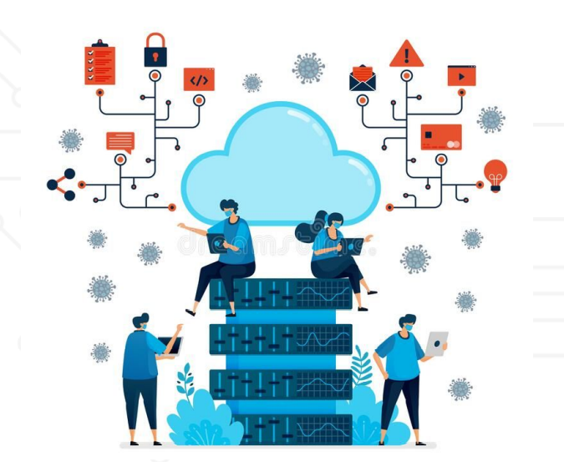
Actors on the scene
The people, whose jobs involve the day-to-day use of a database are called as 'Actors on the scene', listed as below:
1.Database Administrators (DBA)
2. Database Designers
3. End Users
4. System Analyst
5. Application Programmers (Software Engineers)

Slide 12
Workers behind the scene
Those who work to maintain the database system environment but who are not actively interested in the database contents as part of their daily job
Database Designers and Implementers: These people who design and implement the DBMS modules and interfaces as a software package.
2. Tool Developers: Include persons who design and implement tools consisting the packages for design, performance monitoring, and prototyping and test data generation.
3. Operators and maintenance personnel: These re the system administration personnel who are responsible for the actual running and maintenance of the hardware and software environment for the database system

Slide 13
Entity Relationship Model (ER)
Developed by Peter Chen in 1976 in the seminal paper “The Entity-Relationship Model: Toward a Unified View of Data.”
Describes the things that are of interest to a business to perform business processes
Result of a systematic analysis of the business processes and the relevant data schemas
Modelled as a collection of entities and relationships among the entities
Similar to Unified Modeling Language (UML), widely used in software design.

Slide 14
Entity Relationship (ER) Diagram
A diagram that shows how “entities” such as people, objects, or concepts relate to each other within a system.
They are used to design or debug database systems
An easy to understand way to communicate the database design to all relevant stakeholders
A set of defined symbols such as rectangles, diamonds, ovels, and lines are used to denote entities, relationships between entities, and their attributes
Generally nouns are mapped to entities and verbs to relationships

Slide 15
Uses of ER models
Database design
model and design relation databases
capturing the requirements of an information system
Database troubleshooting
analyze existing databases to find and resolve problems
diagrams help visual inspection and identification of issues
Business process reengineering (BPR)
analyze the current use of the databases in the business processes
help re-engineering and modelling the new database setup

Slide 16
Components of ER models
ER Model
Entity
Attribute
Relationship
Weak Entity
Key
Composite
Multivalued
Derived
One to One
One to Many
Many to One
Many to Many

Slide 17
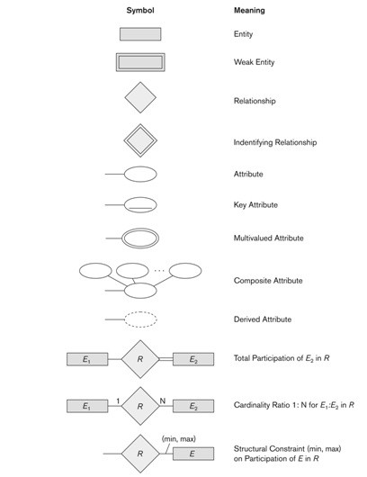
Components of ER models

Slide 18
Entity
An definable object or thing within the system
An object with physical existence (e.g., a lecturer, a student, a car)
An object with conceptual existence (e.g., a course, a job, a position)
Generally maps to a noun in the domain description
Denoted by a rectangle in an entity relation diagram

Slide 19
Entities vs Weak Entities
Entities can be classified based on their strength
Independent entities can exist apart from its related entities
They do not depend on another entity for their existence.
The primary key is not a foreign key.
The primary key may be simple or composite.
They are the main building blocks of a database.
Entity is called a weak entity if it can not exist as a standalone entity but has to depend on another entity
Weak entities should always have a relationship with another entity

Slide 20
Examples
Entities
Weak Entities
Student
Bank Account
Bank
Course
Spouse
Employee

Slide 21
Relationships
Relationships are the glue that holds the tables together
They show the connection between two entities
Relationship strength is based on how the primary key of a related entity is defined
non-identifying, relationship exists if the primary key of the related entity does not contain a primary key of the parent entity.
A strong, or identifying, relationship exists when the primary key of the related entity contains the primary key of the parent entity.

Slide 22
Types of relationships
One to One
A single instance of entity is associated with a single entity
One to Many
A single instance of entity is associated with more than once instance of the other entity
Many to One
More than one instance of an entity is associated with a single instance of the other entity
Many to Many
More than one instance of an entity is associated with more than one instance of the other entity

Slide 23
Identification of entities
A person can own exactly one passport.
A customer can place many orders.
Many employees work for a company.
A student can participate in many courses. A course can have many students.

Slide 24
Identification of relations
A person can own exactly one passport.
A customer can place many orders.
Many employees work for a company.
A student can participate in many courses. A course can have many students.

Slide 25
One to One
A person can own exactly one passport.
1
own
1
Person
Passport

Slide 26
One to Many
A customer can place many orders.
1
place
M
Customer
Order

Slide 27
One to Many
Many employees work for a company.
M
work for
1
Employee
Company

Slide 28
Many to Many
A student can participate in many courses. A course can have many students.
M
participate
M
Student
Course

Slide 29
Identifying relationship
An employee can have a spouse who gets employee benefits.
1
has
1
Employee
Spouse

Slide 30
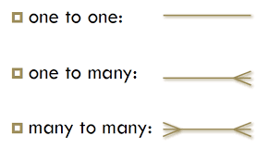
Relationships

Slide 31
Attributes
Attributes describes the properties of an entity
They map to columns of a table
They are four main types of attributes
Key attributes
Composite attributes
Multivalued attributes
Derived attributes

Slide 32
Identification of attributes
The following information about a student is recorded in the system: first name, last name, birthday, email, and city. In addition, each student is assigned a unique student id that can be used to identify the student.

Slide 33
Identification of attributes – Primary Key
The following information about a student is recorded in the system: first name, last name, birthday, email, and city. In addition, each student is assigned a unique student id that can be used to identify the student.
First name
Student ID
Last name
Student
Birthday
City
Email

Slide 34
Identification of attributes - composite attributes
Address of each student is recorded in the system. An address consists of a street, city, state, country and a postal code.
Street
City
Student
Address
State
Country
Postal Code

Slide 35
Identification of attributes – multivalued attributes
A student can have multiple email addresses.
Student
Email Address

Slide 36
Identification of attributes
The birthday of a student is recorded in the system. Student’s age at any given time can be derived from the birthday by subtracting it from the current day.

Slide 37
Identification of attributes – derived attributes
The birthday of a student is recorded in the system. Student’s age at any given time can be derived from the birthday by subtracting it from the current day.

Slide 38
Example
A car-insurance company whose customers own one or more cars each. Customers have a driver id, a name, and an address. Each car has a license plate number, a model, and a manufactured year. Each car has associated with it zero to any number of recorded accidents. For each accident a report number, date, location, and damage amount are recorded.

Slide 39
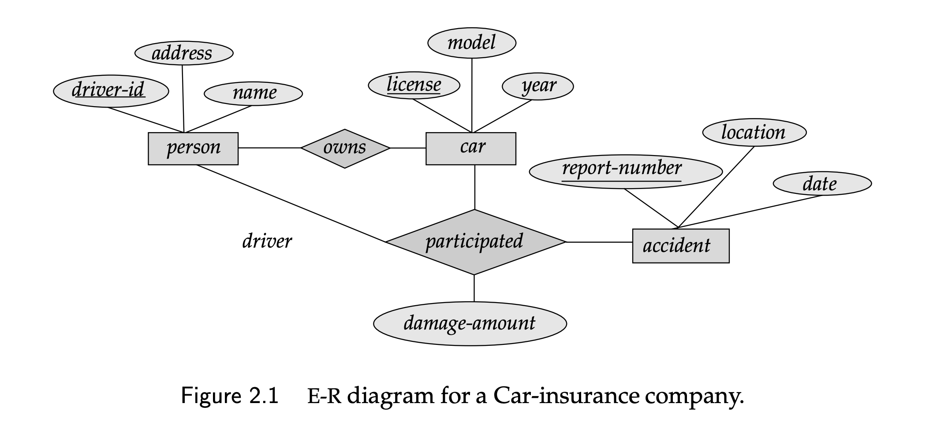
Example

Slide 40
QUESTION
“ABC hospital has a number of departments, rooms, doctors, nurses, and other staff working. Patients having different conditions visit and get checkup done from the doctors and if necessary they are admitted and discharged after recovering.”
1) Build an entity-relationship diagram for the above scenario.

